Slide 1
Ready Seat Go
Aman Patel, Ben Renaud, Matt O’Brien
Prakort Lean, Shivani Pasnara, Prashil Zinjuwadia

Slide 2
ER Diagram
Ready -> Seat -> Go

Slide 3
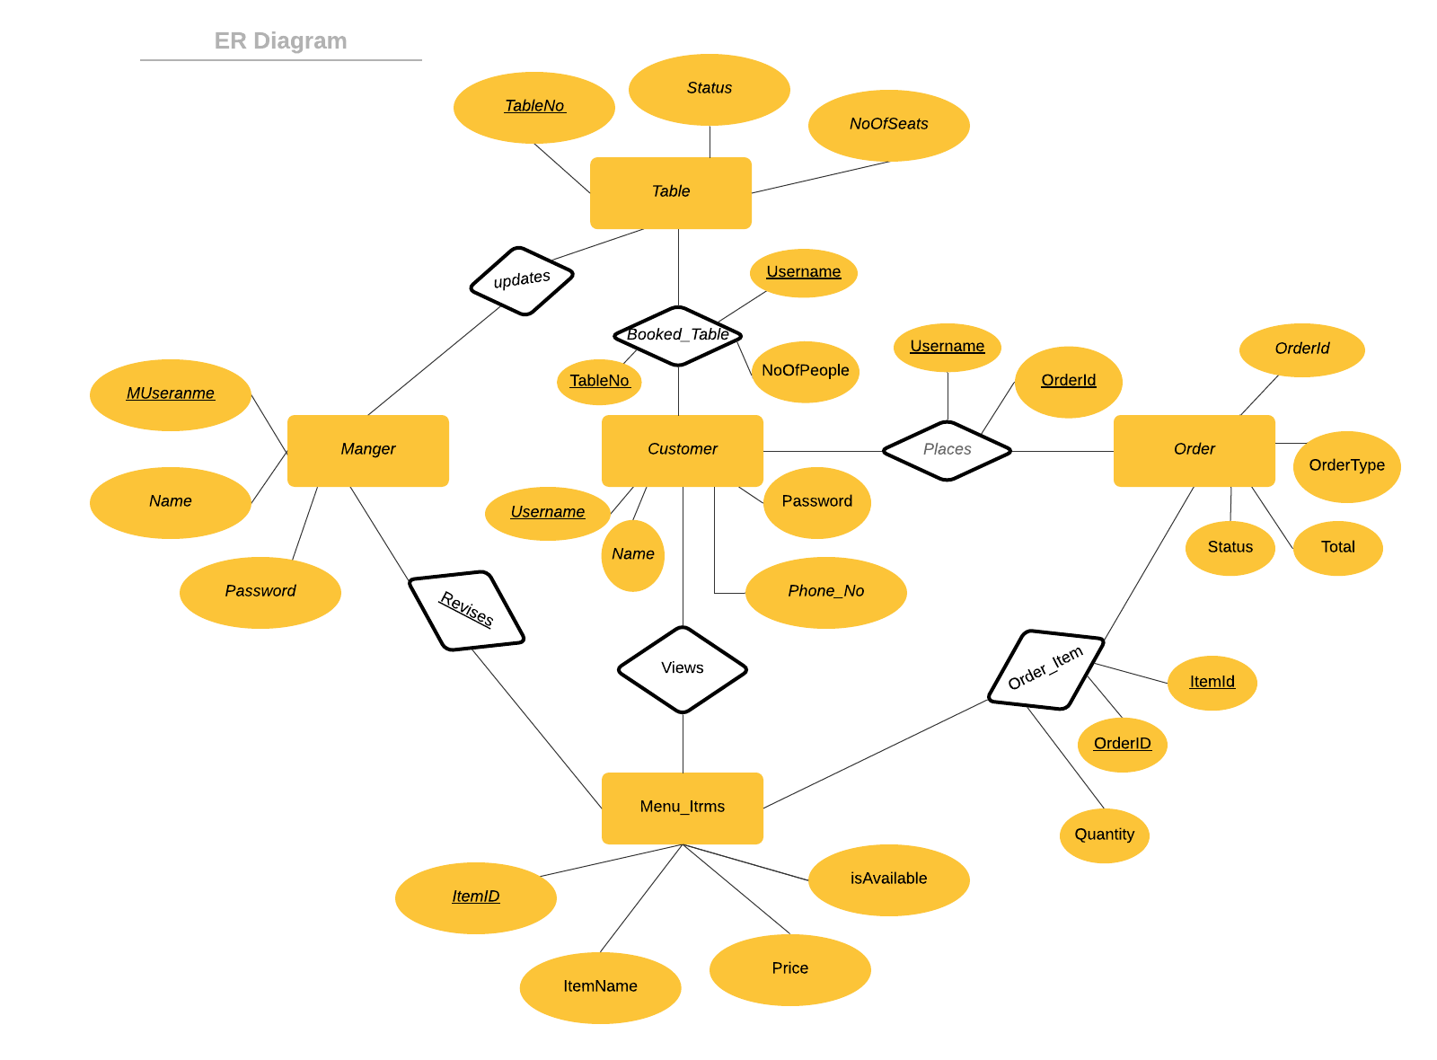
ER DIAGRAM

Slide 4
Software & Hardware Specifications
Ready -> Seat -> Go

Slide 5
Software & Hardware Specification
Hardware
This software will be run on any web browser with internet network support. The required operating system can be Window x32, x64, Linux, and MacOS. Since it is a web application, it does not require memory to be downloaded onto the devices. The minimum screen size should be 640x480 pixels, and the largest screen size should be 1920x2160 pixels.
Specification | Standard Client | Standard Web Server | Standard Application Server | Standard Database Server
Operating System | -Windows running Internet Explorer | -Linux | -Linux | -MYSQL
Hardware | 8 GB Memory 250 GB disk drive | 8 GB Memory 1TB disk drive | 32 GB Memory 1-2 TB disk drives | 32 GB Memory 1-4 TB disk drives
Network | 100 Mbps Ethernet | 100 Mbps Ethernet | 100 Mbps Ethernet | 100 Mbps Ethernet
Software
This web application works within a web browser and uses a database server. The application will use the database to store the user information as well as the orders’ details.

Slide 6
First-Cut Design Class Diagram
Ready -> Seat -> Go

Slide 7
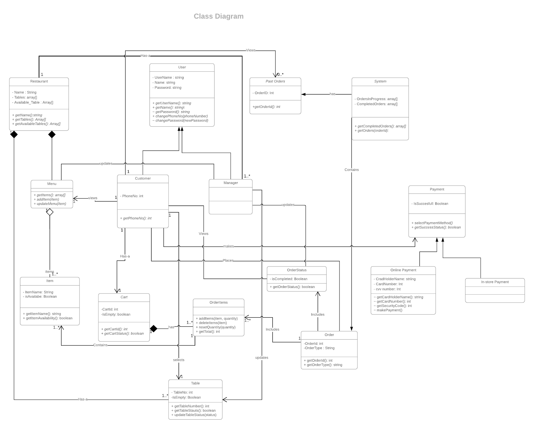
First-Cut Design Class Diagram

Slide 8
Sequence Diagrams
Ready -> Seat -> Go

Slide 9
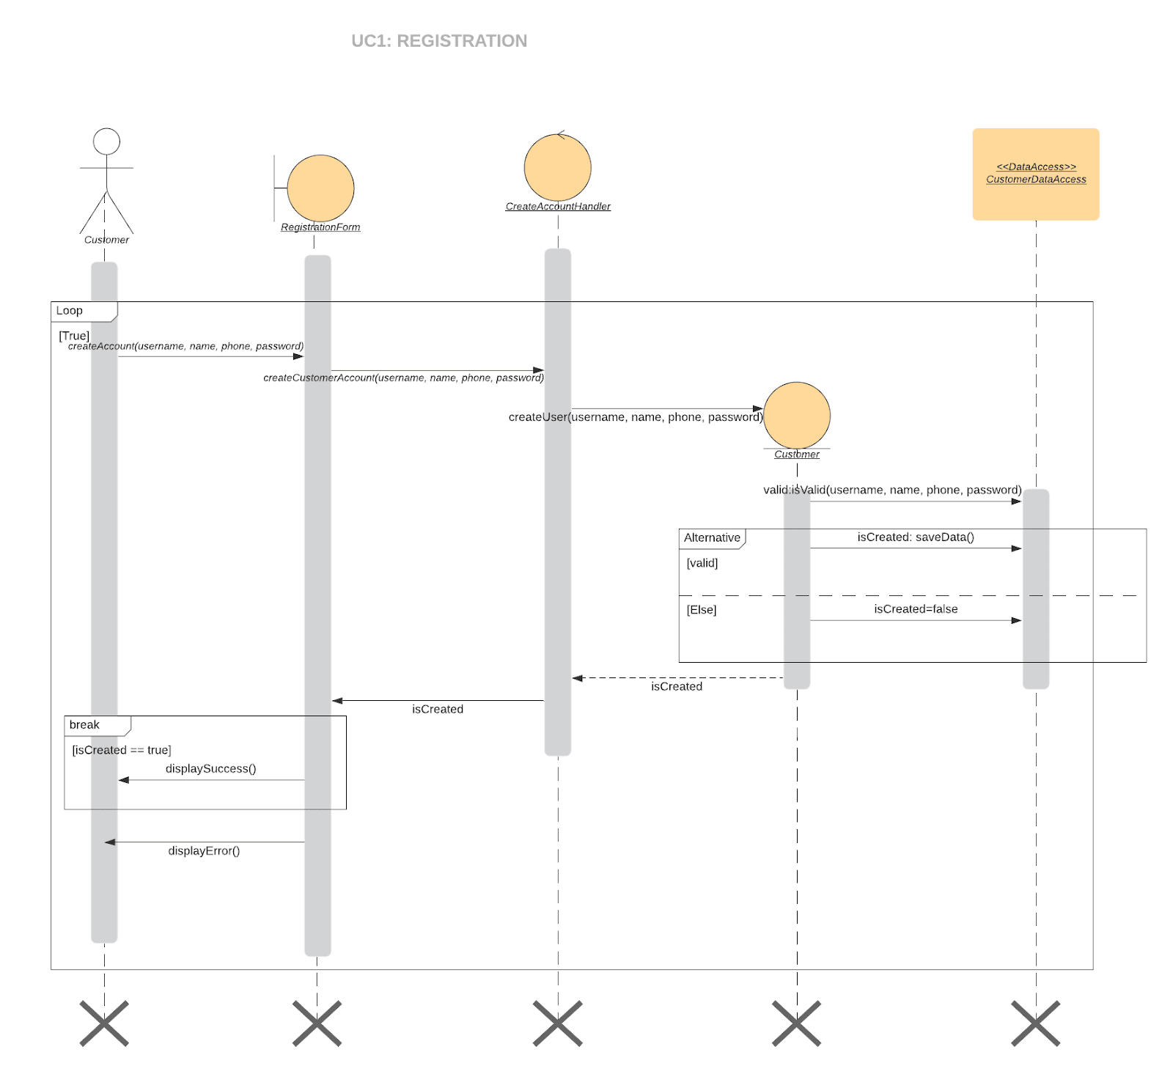
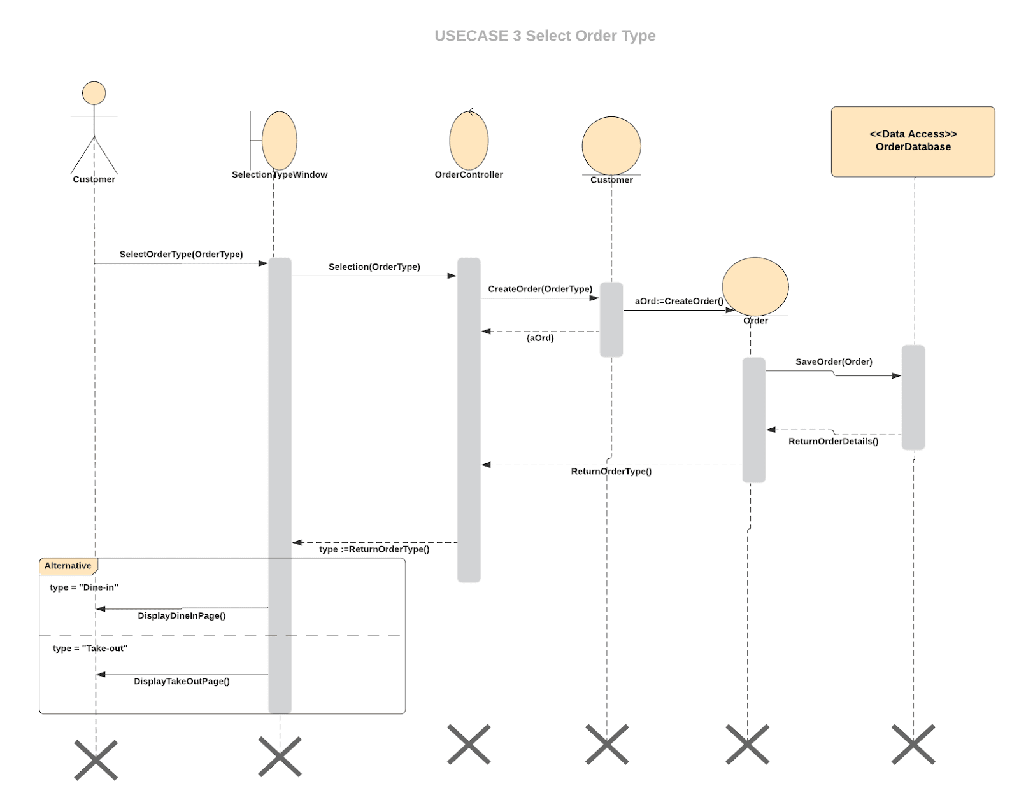
Sequence Diagrams
Registration
Select Order Type

Slide 10
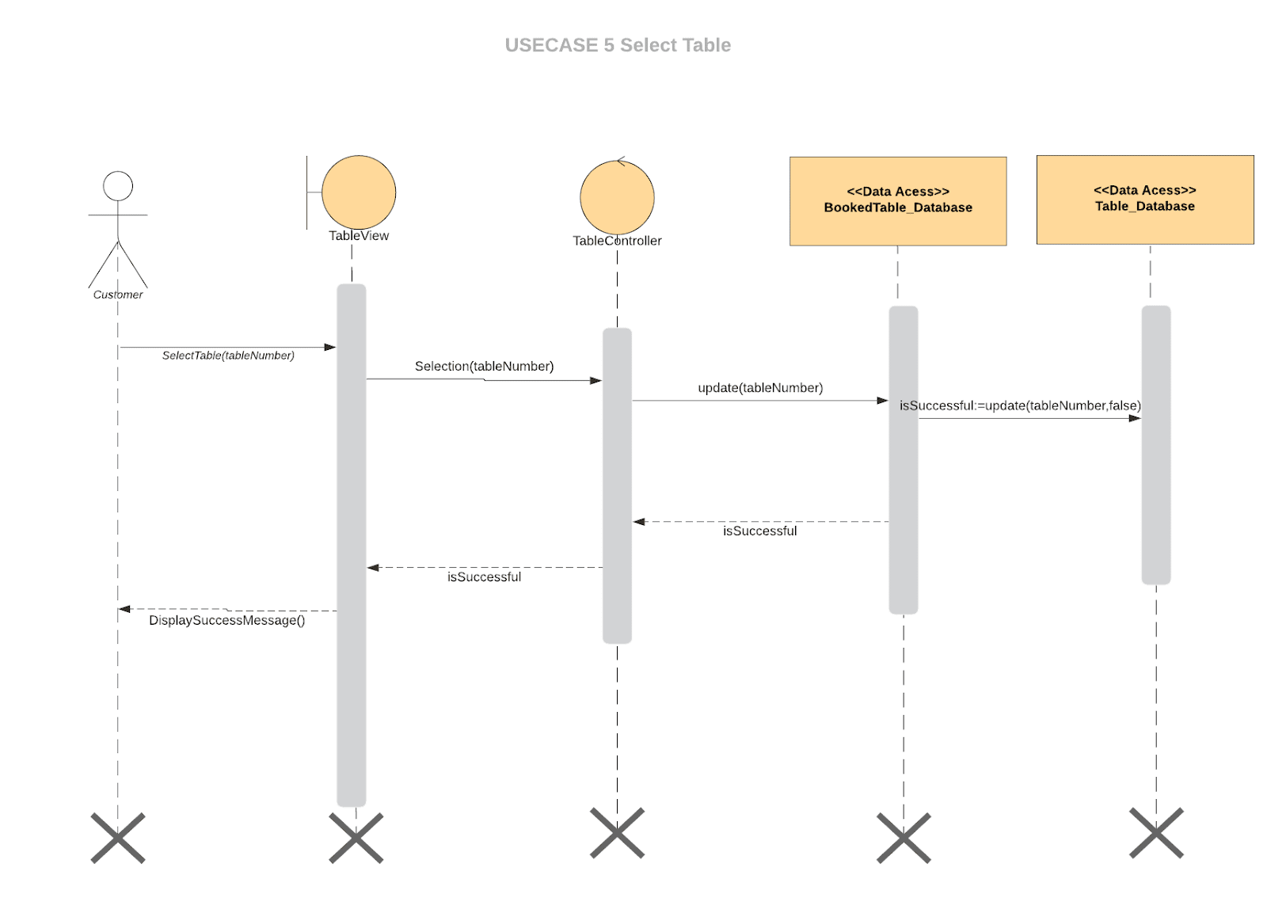
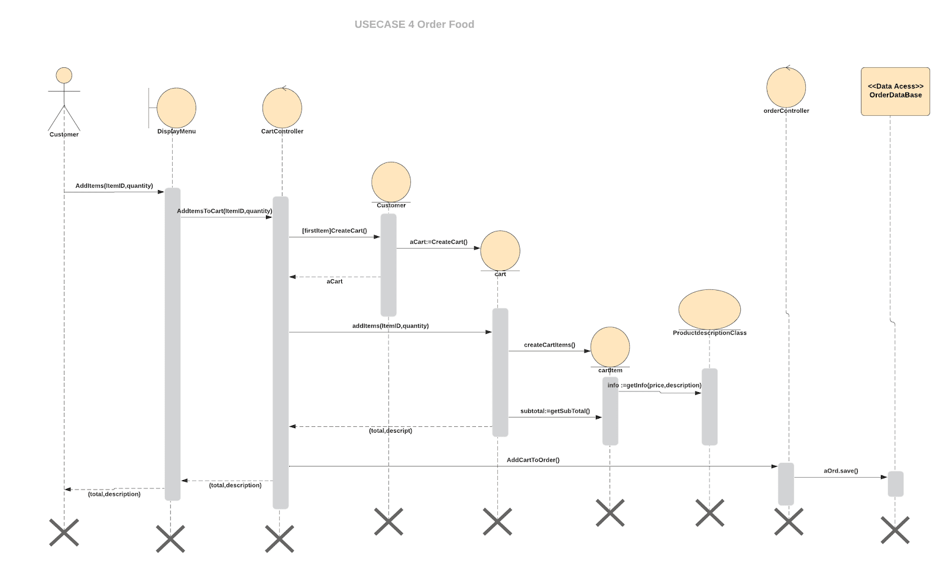
Sequence Diagrams #2
Select Table
Order Food

Slide 11
Three-Layer Design Class Diagram
Ready -> Seat -> Go

Slide 12
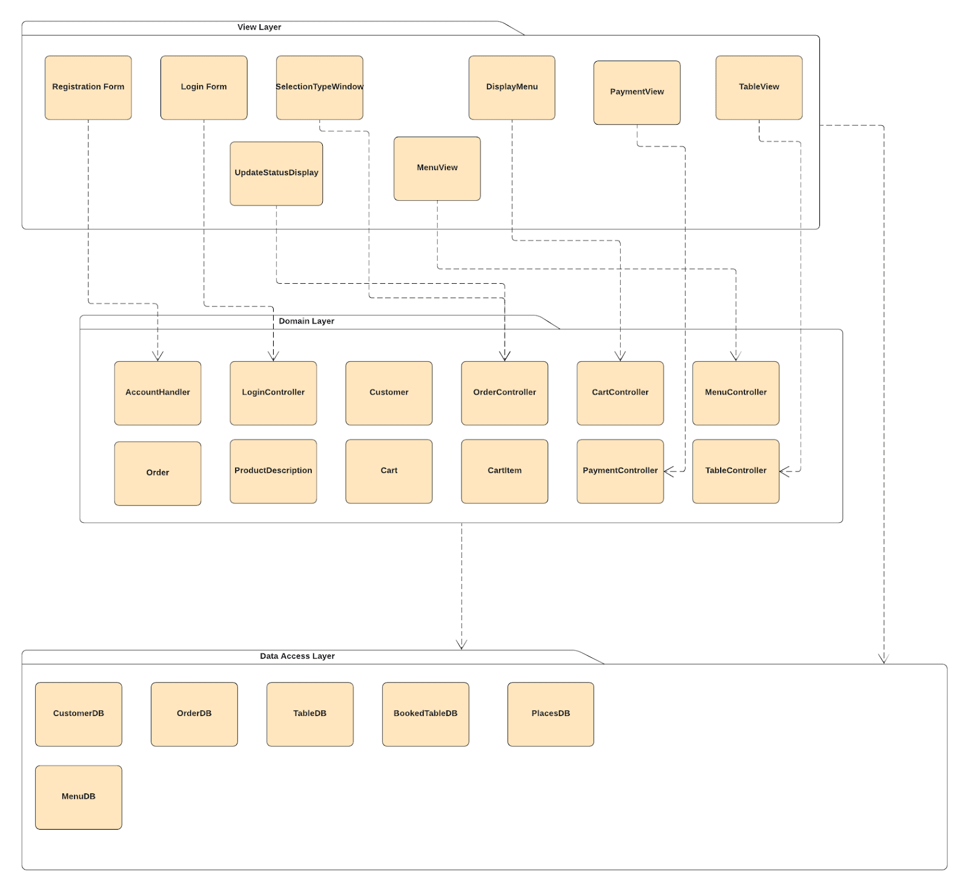
Three-Layer Design Class Diagram

Slide 13
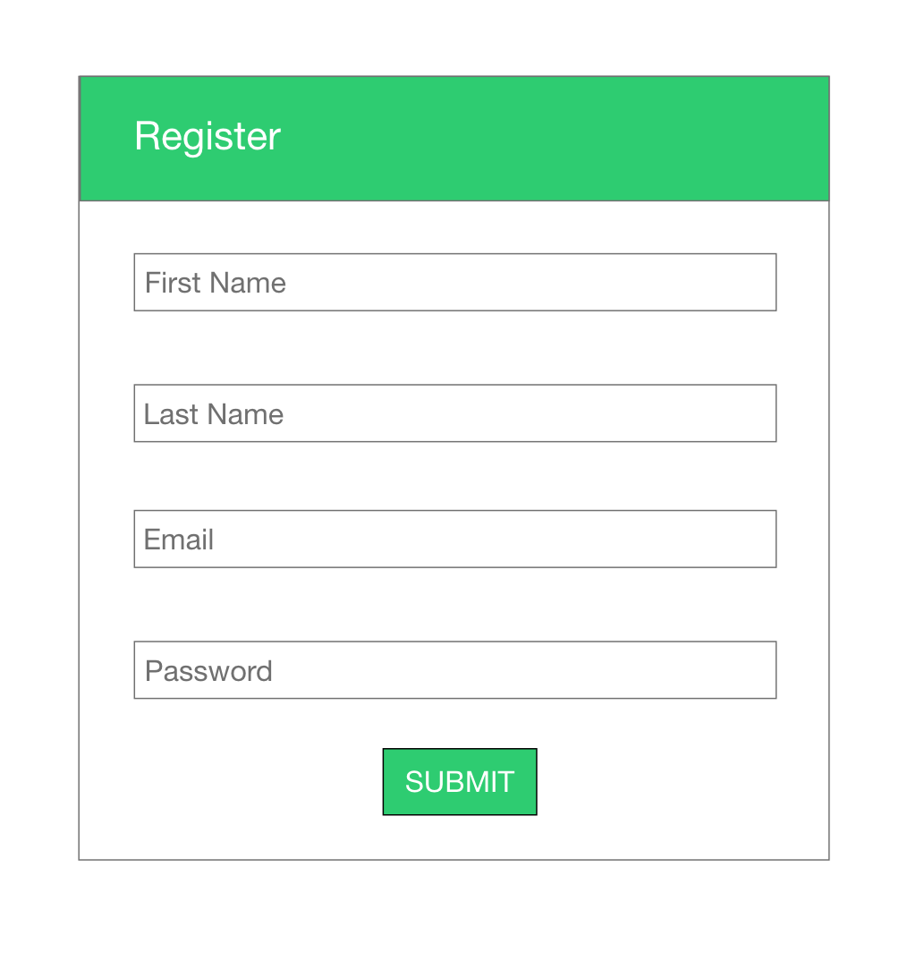

Interface Design
Ready -> Seat -> Go

Slide 14
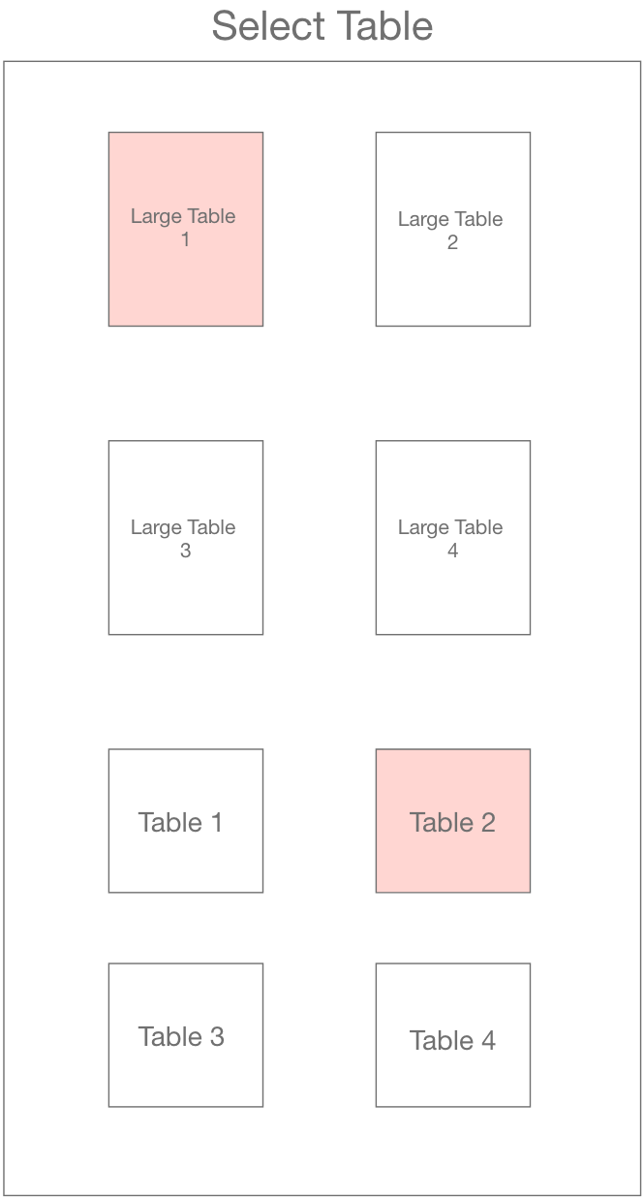
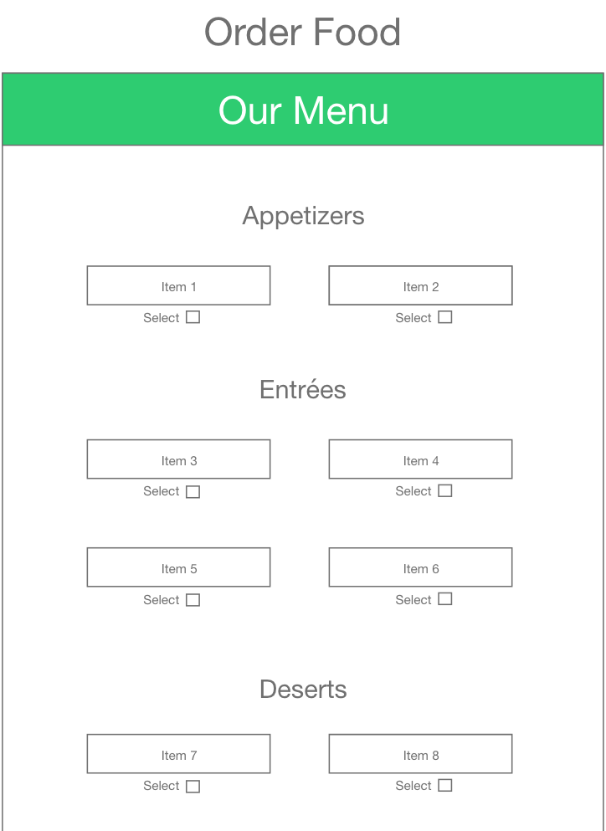
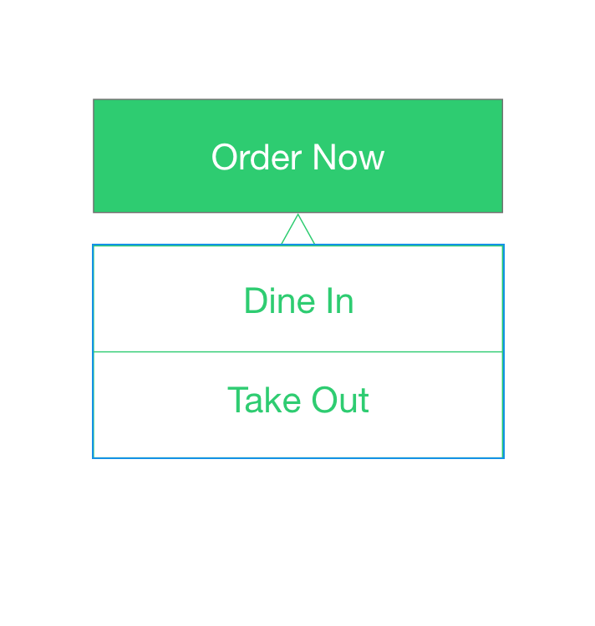
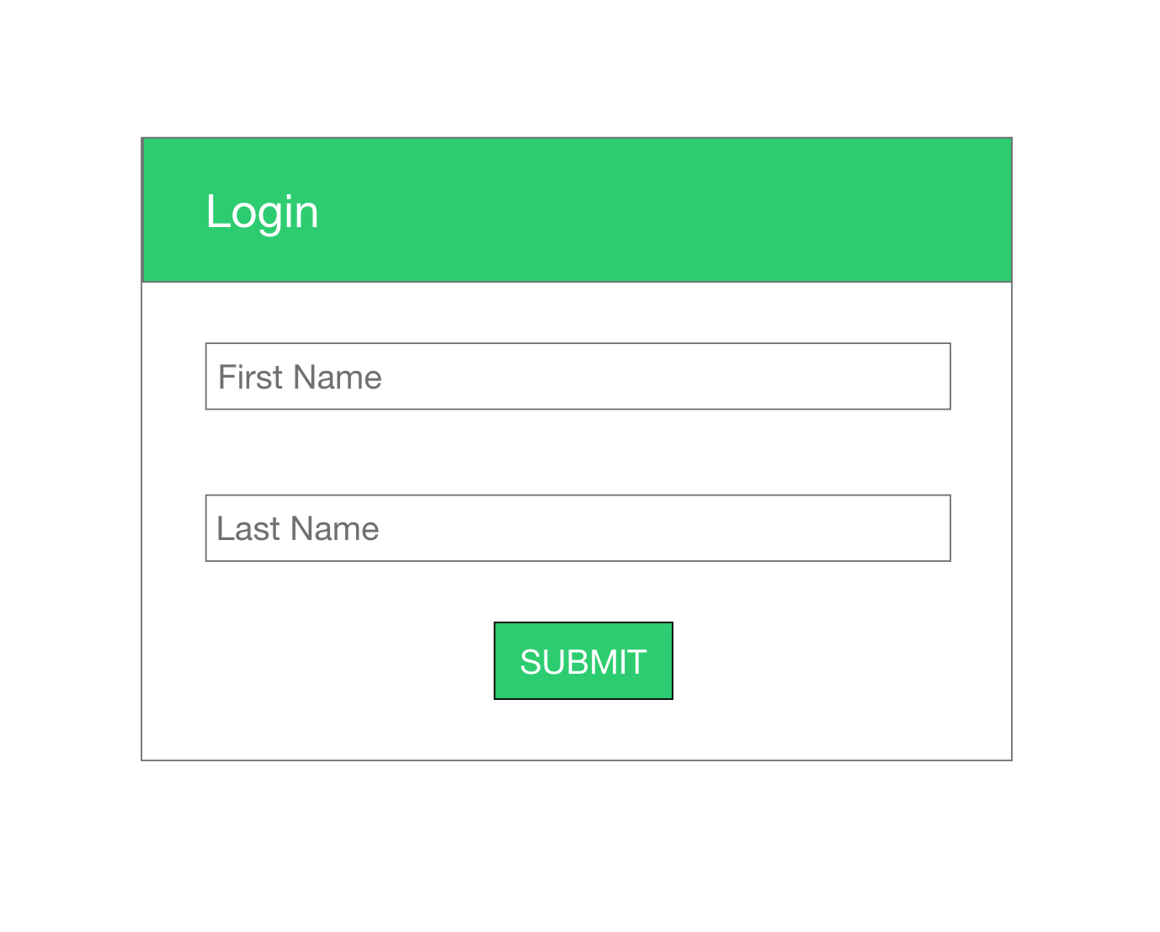
Interface Designs

Slide 15
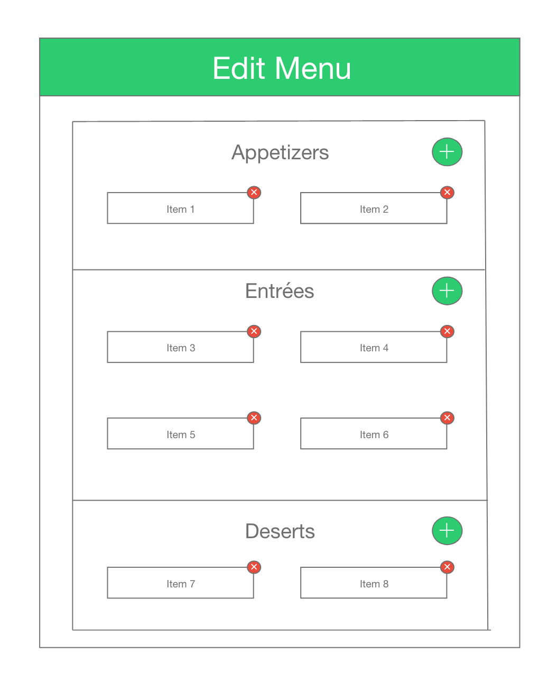
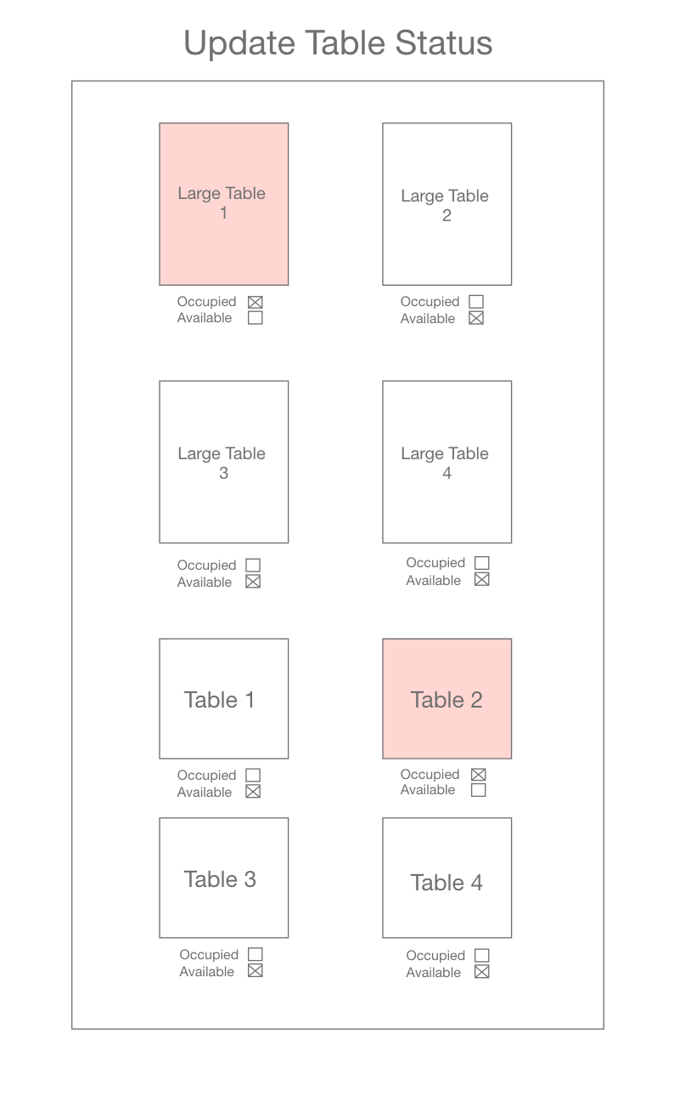
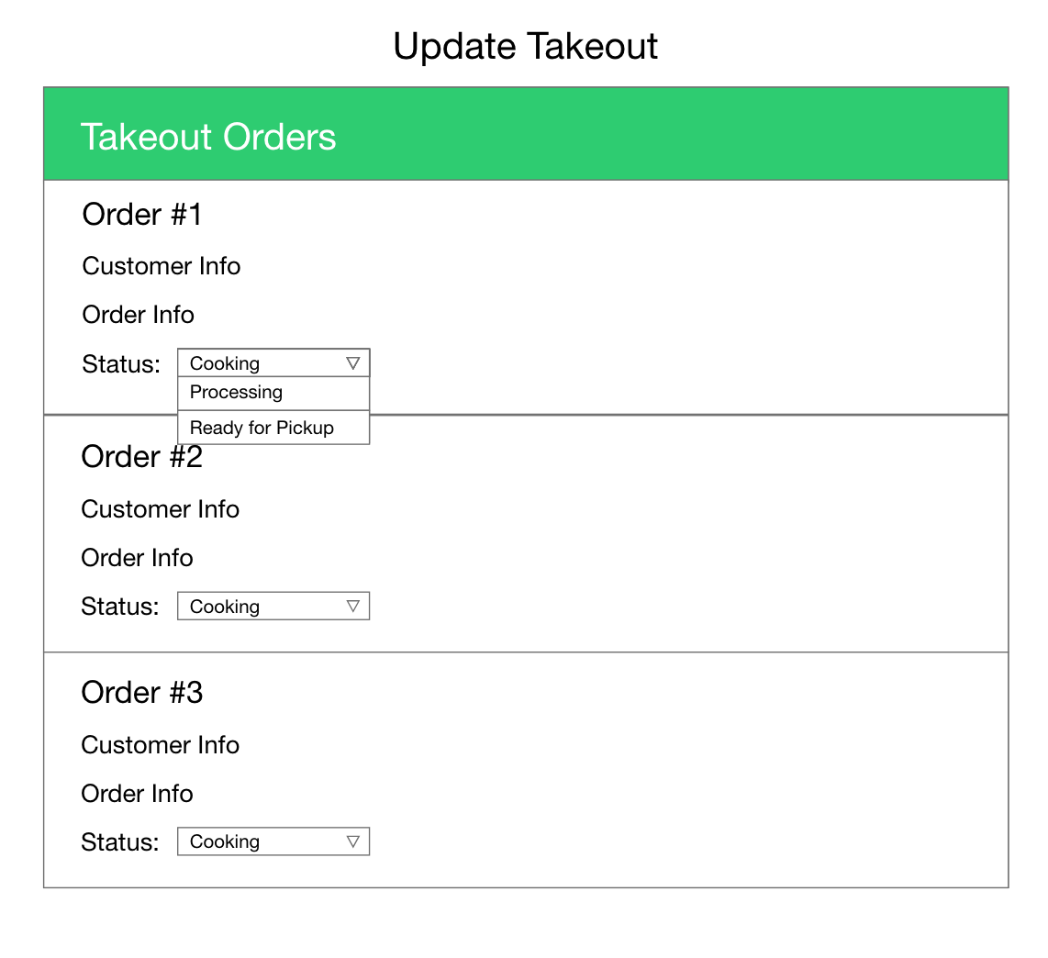
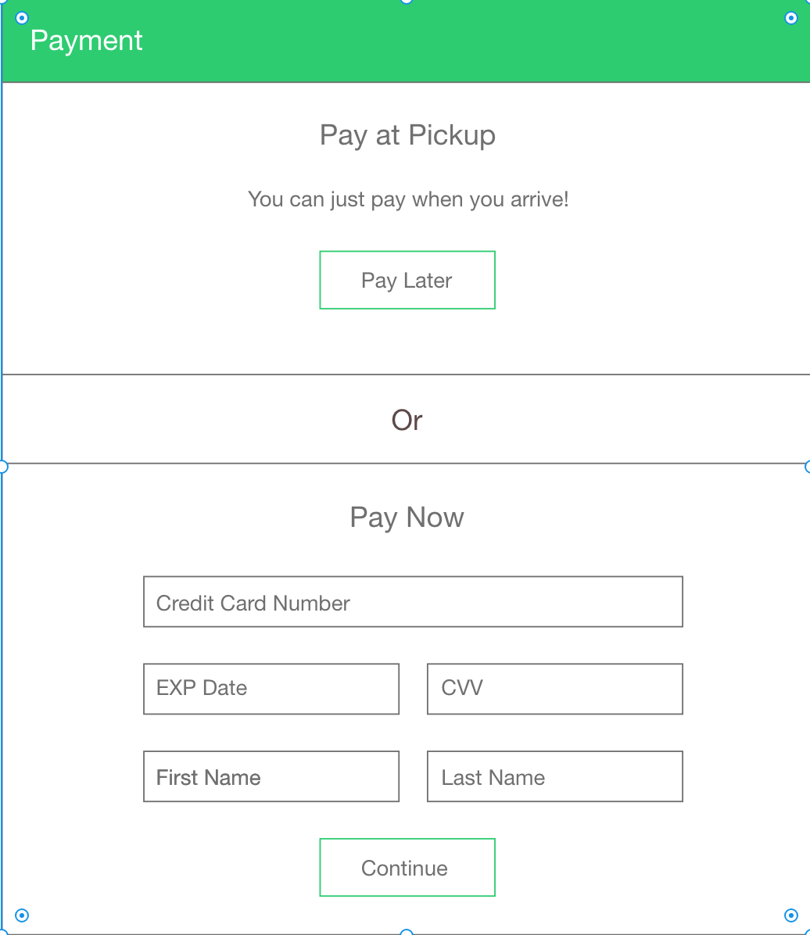
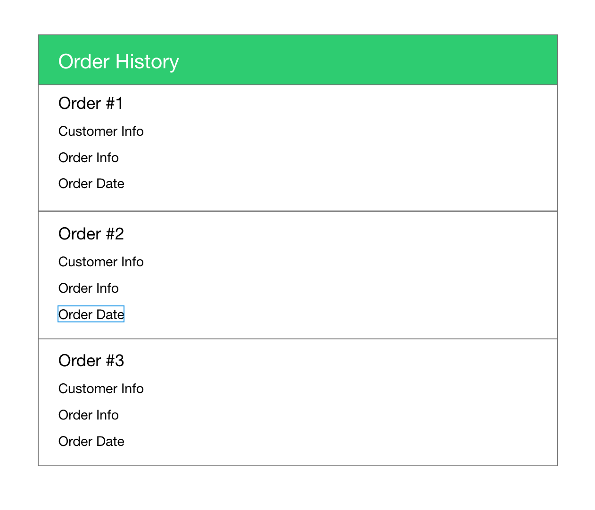
Interface Designs #2

Slide 16
Table Diagram
Ready -> Seat -> Go

Slide 17
Table Diagram
Customer Table
Manager Table
Username | Name | Phone_No | Password
Legend:
Bold - Foreign Key (FK)
Underlined - Primary Key (PK)
Customer(Username, Name, Phone_No, Password)
Manager(MUsername, Name, Password)
Table(TableNo, Status, NoOfSeats)
Menu_Items(ItemID, ItemName, Price, IsAvailable)
Order(OrderID, Status, OrderType, Total)
Order_Item(OrderID, ItemID, Quantity)
Places(Username, OrderID)
Booked_Table(Username, TableNo, NoOfPeople)
MUsername | Name | Password
Table Table
TableNo | Status | NoOfSeats
Menu Table
ItemID | ItemName | Price | IsAvailable
Order Table
OrderID | Status | OrderType | Total
Order Item Table
OrderID | ItemID | Quantity
Places Table
Username | OrderID
Booked_Table Table
Username | TableNo | NoOfPeople

Slide 18
TEAM SLIDE
Aman Patel
Ben Renaud
Shivani Pasnara
Matt O’Brien
Prakort Lean
Prashil Zinjuwadia

Slide 19
THANK YOU!
Ready -> Seat -> Go

